Slide 1
Object-Oriented System Analysis and Design
By: Yumesh Ban
Date : 25 January

Slide 2
Introduction tO OOsad
Definition and Purpose:
Object-Oriented System Analysis and Design (OOSAD) is a methodology that focuses on using objects as the primary units of analysis and design.
Importance in Modern Software Development:
It facilitates more natural modeling of real-world entities
Promotes reusability and maintainability in software development.

Slide 3
Traditional vs. Object-Oriented Approach
Traditional:
Process-centric or data-centric problem decomposition
Object-oriented:
Balances process and data by focusing on objects containing both.

Slide 4
Emergence of Object-Oriented Methodologies
Difficulty in modeling real-world systems with traditional approaches.
Emergence of RAD-based object-oriented methodologies
Focus on objects that contain data and processes

Slide 5
Oosad Nature representation:
Object Oriented Design is the process for demonstrating logical and physical as well as static and dynamic models of the system under the design so it requires SDLC.

Slide 6
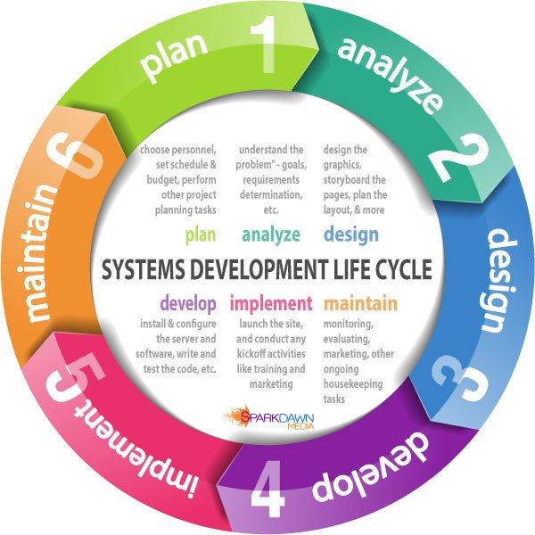
System Development Life Cycle (SDLC)
Phases of SDLC:
Planning
Analysis
Design
Implementation
Maintenance

Slide 7
Core Principles of OOSAD
Use case driven
Architecture centric
Iterative and incremental development

Slide 8
Use Case Driven Approach
Definition and importance of use cases
Use cases as primary modeling tool
Simplicity in focusing on one activity at a time

Slide 9
Architecture Centric Approach
Importance of system architecture in specification, construction, documentation
Three architectural views: Functional, Static, Dynamic

Slide 10
Functional View
External behavior of the system from user perspective
Relation to process-modeling in structured analysis

Slide 11
Static View
Structure of the system: attributes, methods, classes, relationships, messages
Relation to data-modeling in structured analysis

Slide 12
Dynamic View
Internal behavior of the system: messages between objects, state changes within objects
Combination of process and data-modeling approaches

Slide 13
Iterative and Incremental Development
Continuous testing throughout the project lifecycle
System evolves to meet user needs with each iteration

Slide 14
Benefit of each Approach
Use Case Driven Benefits:
Improved communication between users and analysts
Better understanding of user needs
Architecture Centric Benefits:
Comprehensive system understanding from multiple views
More complete depiction of information system
Iterative and Incremental Development Benefits:
Continuous testing and refinement
Higher quality systems that meet user needs

Slide 15
Key Concepts And their Benefits
Classes , Objects & Methods:
Realistic modeling, better communication
Encapsulation:
Loosely coupled units, fewer ripple effects.
Inheritance:
Less redundancy, faster creation of new classes
Polymorphism:
Simpler event programming, ease in replacing objects

Slide 16
Benefits of OOSAD
Realistic modeling of business processes
Improved communication between users and developers
Reusable objects and system components

Slide 17
Challenges in OOSAD
Complexity:
Managing and designing complex systems can be challenging.
Learning Curve:
Requires understanding of object-oriented concepts and UML.
Integration:
Integrating with existing systems and legacy code can be difficult.

Slide 18
Best Practices
Tips for Effective OOSAD:
Clear Requirements Gathering: Ensure requirements are well-defined and understood.
Consistent Use of UML: Use UML diagrams consistently for documentation.
Iterative Development: Use iterative and incremental development approaches to manage complexity.

Slide 19
Conclusion
We learned about the OOSAD principles and benefits.
We also reviewed the importance of OOSAD in modern information systems development
We emphasized the benefits, such as reusability, scalability, and maintainability.

